Slide 1


Classification Modeling
Michael Pomatto
Data 728

Slide 2

Weekly Objectives – Week Two
Cross-Industry Process for Data Mining (CRISP-DM)
Define your business objective.
Define the modeling approach and design a modeling process. This may include additional data that you choose to bring into your model in addition to files provided.
Investigate your data sources
Select which to use
Perform basic exploration of your data, validation, and cleaning.
Enrich your data.
Provide guidance on the validation of your data.
CRISP-DM Steps
Business Understanding
Data Understanding
Data Preparation

Slide 3
Classification and Behavioral Segmentation Modeling
Classification Modeling
One that attempts to draw some conclusion from observed values. This typically will take the form of one of two types:
Supervised – Training data is an input into a classification algorithm and compared against a known outcome. For example, classifying if an e-mail is spam or not based on previous examples.
Unsupervised – Commonly seen as clustering. This looks for anomalies or outliers.
Behavioral Segmentation Modeling
Dividing a heterogeneous market into relatively more homogenous segments based on certain parameters like geographical location, demographics, etc.
Purpose: Minimize risk by determining which products have the best chances for gaining a target market share.
Value: Allows you to reach a particular customer segment more effectively. It can also help retain customers.
Data 728 Approach
Classification
Focus heavier on supervised modeling
Bagging and Boosting models
Models: Decision Trees, CHAID, Bayesian, SVM
Behavioral Segmentation
Focus heavier on unsupervised modeling
Clustering evaluation and optimization
Models: K-Means and Two-Step
Notes:
Definitions are taken from Data Science Central; however, they are broadly accepted across the industry.

Slide 4
Datasets Provided – Promotions File
This file contains information regarding three promotional campaigns. Customers were sent all three, and it was recorded on whether they responded back to the promotion. It included a purchase discount, and the amount that each customer received as a discount was also recorded.
Metadata:
Customer_ID: Customer identifier
Promo_*_Response: Whether or not the customer responded (0 = no, 1 = yes)
Promo_*_Discount: The amount of discount they received on their purchase in response to the offer
Transaction File
Customer_ID
Promotions File

Slide 5
Datasets Provided – Transaction File
This file contains the detailed transaction data from all purchases relevant to the same time frame the promotions were active.
Metadata:
Customer_ID: Customer identifier
Transaction_ID: The transaction identifier. The combination of Customer_ID and Transaction_ID make up the primary key of this data.
Payment_Method: Type of payment used in the transaction.
Timestamp: Time of the transaction.
Product_Code: What product was purchased in the transaction.
Qty: How many of that product were purchased.
Sales_Amount: Total sales amount of that transaction

Slide 6
Example of Creating a New Dataset for the Exercise
If you decide to create your own dataset to help enrich the data, it is important that you document the purpose in your analysis document. Here is an example from a previous student who created a Products table. It essentially used the product code to which he added a product category and unit cost. Adding data like this allowed further analysis beyond the elementary pieces of just the discount or purchasing behavior.
Metadata:
Product_Code: The product code of the particular item.
Product Category: Each product falls into one category. This really becomes valuable when doing clustering models.
Unit Price: The cost of one unit.
Transaction File
Merge
Customer_ID
Product_Code
Promotions File
Product File

Slide 7
CRISP-DM Framework: Business Understanding
Purpose: To establish understanding of the business problem from the customer perspective.
Example Questions:
What is the strategic approach?
Who are the key customers?
What are the customer’s broad objectives?
What is the customer doing today around the problem?
What are the specific needs to improve the current state and/or fulfill objectives?
What are the model / output components that would determine a successful deliverable?
Have the components been restated back to the customer, and if so what was the response?
Deliverable: Analysis document

Slide 8
CRISP-DM Framework: Data Understanding
Purpose: To establish understanding of what data sources are available to address this problem.
Example Questions:
What data sources are available?
What sources can be used to map to the output components?
How will those data sources be accessed?
What features will be extracted from each data source?
What are the qualities of the data that can be mapped back to the KPIs?
Deliverable: SPSS Stream with Data Understanding
These items will come when you get to the modeling step. It is a good idea to start thinking about them early because it may help influence decisions with the data understanding.
What are your KPIs / Metrics of success?
What analytical methods are best suited to the task and why?
How will you evaluate those methods and why?
How do the chosen methods align to the stated problem objectives?
Notes:
Definitions are taken from Data Science Central; however, they are broadly accepted across the industry.

Slide 9
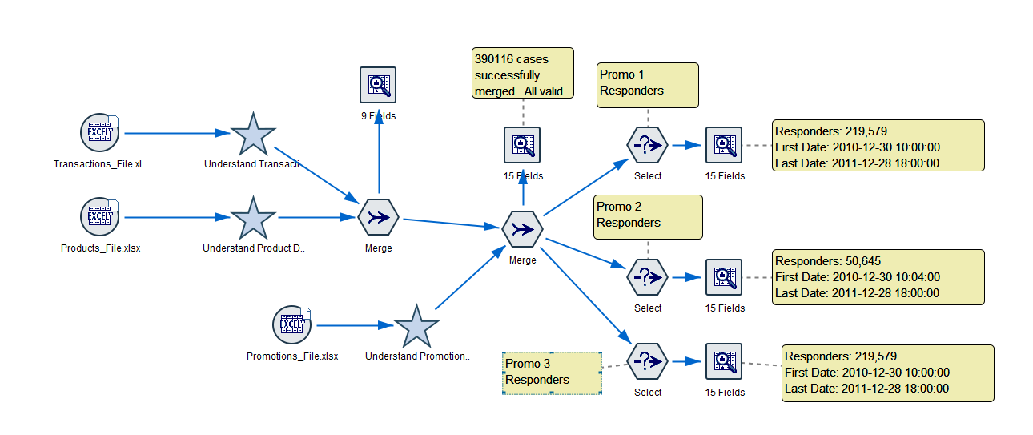
CRISP-DM Framework: Data Understanding
Example Stream – Do Not Simply Submit as Your Work

Slide 10
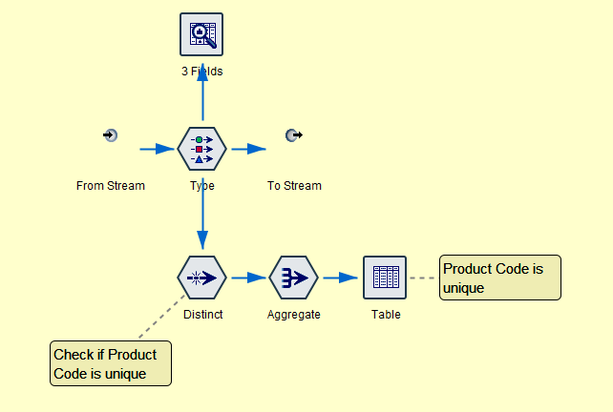
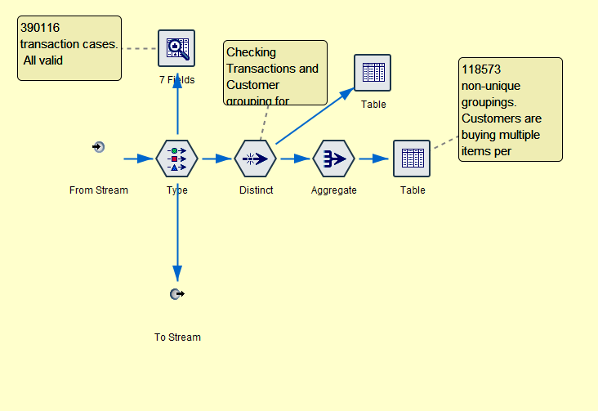
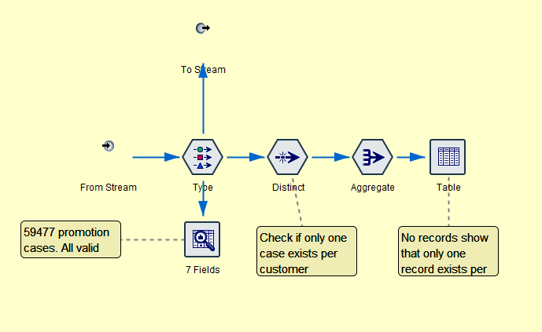
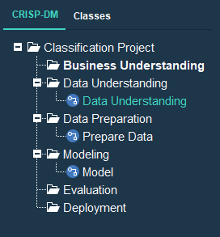
CRISP-DM Framework: Data Understanding
Product
Transaction
This is for illustrative purposes only. Your analysis should look beyond what is being checked in this example.
The deliverable should be the SPSS stream(s) clearly labeled as you see here.
Promotion
Project

Slide 11
CRISP-DM Framework: Data Preparation
Purpose: Using the information documented in the first two steps, begin analyzing the data to prepare it for more advanced modeling.
Profile Data:
Basic Techniques
Purpose – Fundamental description of the data in numeric terms
Goal – Validate the data is consistent and formatted correctly
Examples – Distinct count and percentages, Summary statistics, percent of zero / null.
Advanced Techniques
Purpose – Identify deeper numerical / analytical relationships in the data
Goal – Validate the data is consistent where needed for advanced data profiling
Examples – Key integrity (keys present, accurate, not-null), cardinality (relationships), pattern and frequency distribution.
Contextual Profiling
Understanding each feature to ascertain its role in the business context (drivers)
Goal – Comprehend and contextualize the data / business rules and identify data structures
Examples – Identify data hierarchies, identify unanticipated business rules, functional dependencies
Notes:
Definitions are taken from Data Science Central; however, they are broadly accepted across the industry.

Slide 12
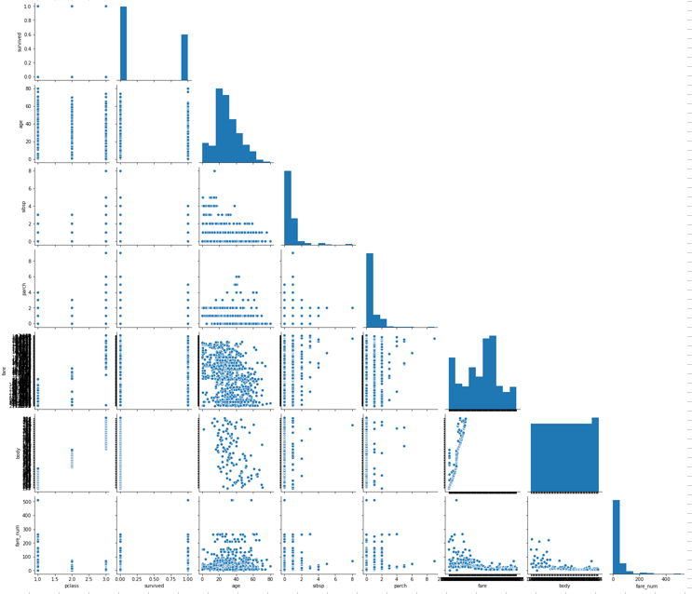
CRISP-DM Framework: Data Preparation
Summary Statistics
Categorical
Field Values
Bivariate Analysis
Obtain data (provided or your additions)
Profile data
Scrub data
Explore data
Model data (next week)
Interpret data (final week)
Notes:
Uses the Titanic dataset for this example

Slide 13
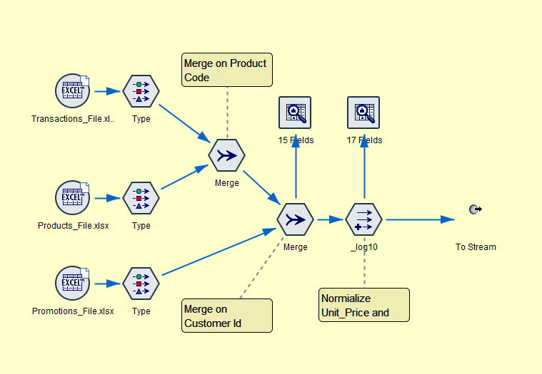
CRISP-DM Framework: Data Preparation
Example Stream – Do Not Simply Submit as Your Work
This is for illustrative purposes only. Your may be different from this example.
The deliverable should be the SPSS stream(s) clearly labeled as you see here.
Notes:
Uses the Titanic dataset for this example

Slide 14
Weekly Objectives – Week Three
Cross-Industry Process for Data Mining (CRISP-DM)
Four elements for the submission:
Build variants of your stream
Use the bagging technique
Use the bootstrapping technique
Evaluate your model
What you will turn in:
Analysis document updated to include the learning from these four steps. You may want to have that as a separate document or (preferred) submit as additional information on your current classification analysis document.
Any SPSS streams that you build or revise
Any data beyond the files provided as part of the assignment
CRISP-DM Steps
Modeling
Evaluation
Iteration

Slide 15
CRISP-DM Framework: Modeling and Evaluation
Purpose: Using the information you have built in the previous steps, take the data and create models.
Example Questions:
What are your KPIs / Metrics of success?
What analytical methods are best suited to the task and why?
How will you evaluate those methods and why?
How do the chosen methods align to the stated problem objectives?
Does the model you produce align with the data requirements and business understanding?
Does the model show correlation?
What issues do you currently see with the model you produced?
What are some variants that could be produced?
Notes:
Definitions are taken from Data Science Central; however, they are broadly accepted across the industry.

Slide 16
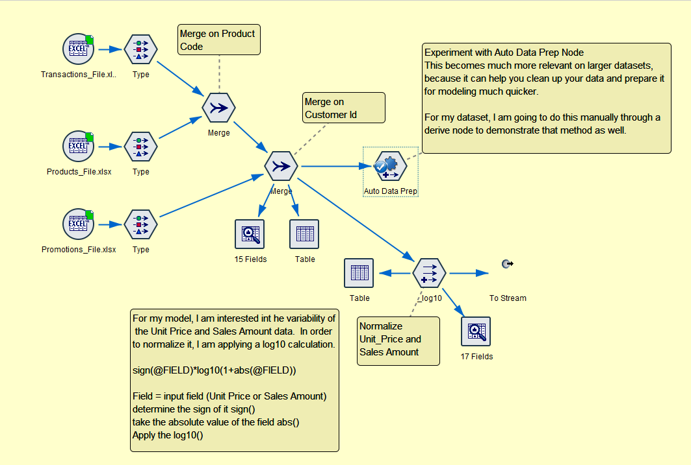
CRISP-DM Framework: Modeling
Example Stream – Do Not Simply Submit as Your Work
Auto Data Prep Node
This is the finalized data preparation stream. It is in a super node to keep things clean.
We will explore two parts of this in greater detail.
Normalizing Manually

Slide 17
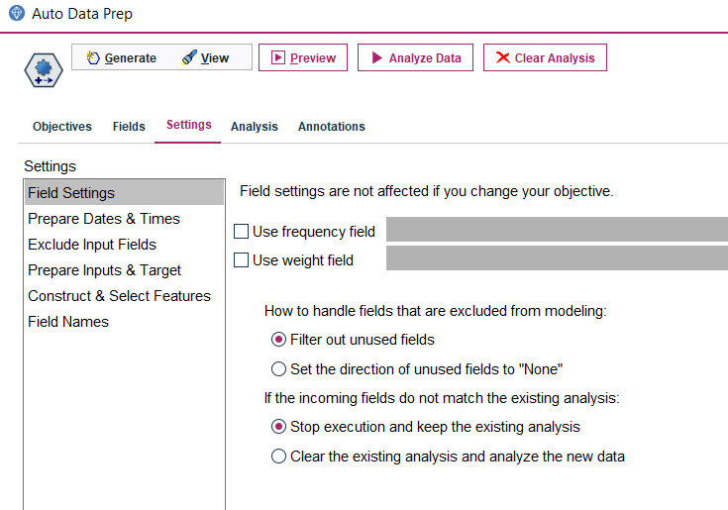
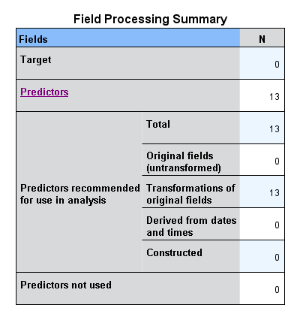
CRISP-DM Framework: Modeling – Auto Prep Node
Example Stream – Do Not Simply Submit as Your Work
Analyze data will run your data through the presets.
Analysis will give you the results
Three options of the summary, field information, and action
What is this telling us?
Based on your data, all predictors used in the input should be considered
The node is providing transformed versions of all fields. You have to decide whether or not this makes sense.
Example: The record identifier is being considered as one of the predictors. You would want to filter that out on a model.
Anything downstream of an auto note will filter out your original fields, leaving only the transformed ones.

Slide 18
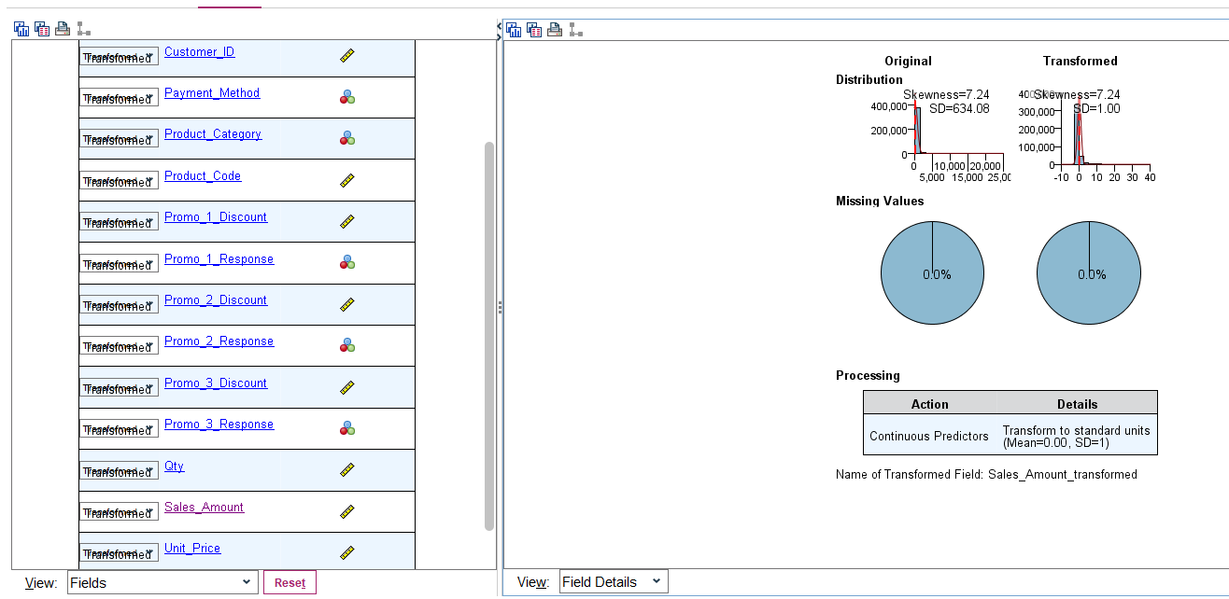
CRISP-DM Framework: Modeling – Auto Prep Node
Example Stream – Do Not Simply Submit as Your Work
What is this telling us?
The field selected (Sales Amount) does not have any missing values
Original values have a rather large standard deviation, and it is skewed. You could also see this if you were to graph the field in the raw form.
The transformed fields will set it to a SD of 1, which will make many types of analysis much more accurate.
Note: Given the relatively small size of the data, the auto prep node is for investigation only. It probably would not make sense in this situation. Do it manually.
Further reading on the auto prep node. This is for the cloud product, but with respect to this functionality it is almost identical.
https://www.ibm.com/support/producthub/icpdata/docs/content/SSQNUZ_latest/wsd/nodes/autodataprep.html

Slide 19
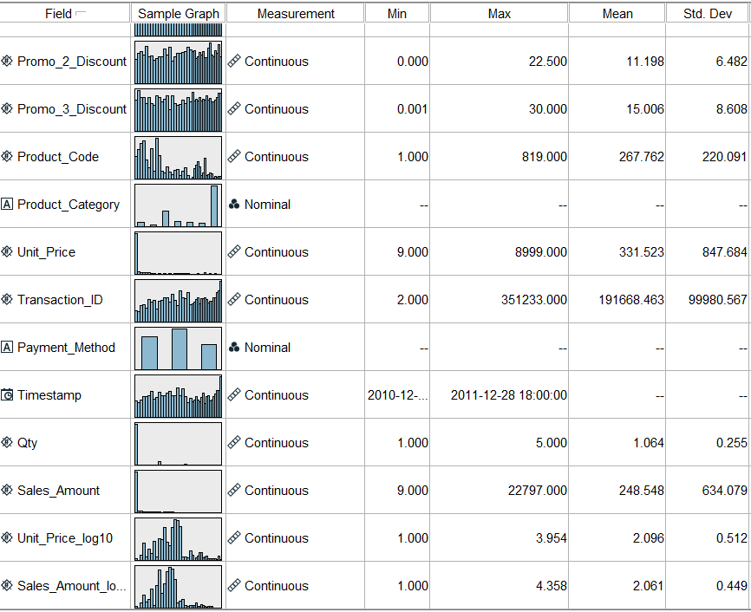

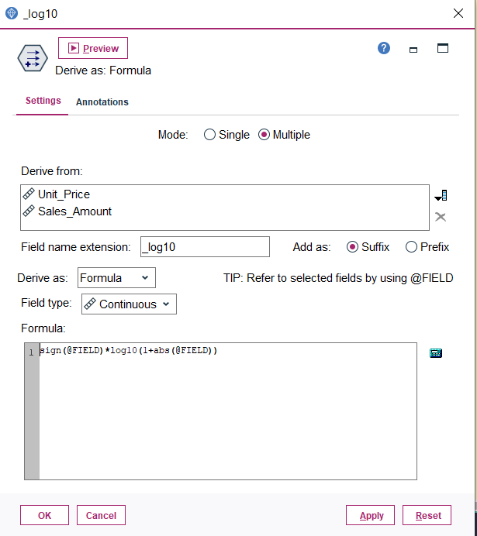
CRISP-DM Framework: Modeling – Normalizing Fields Manually
Example Stream – Do Not Simply Submit as Your Work
Add a derive node
Derive as a formula
Fields to normalize
Derived field name (suffix)
Keep field type the same
Enter formula

Slide 20
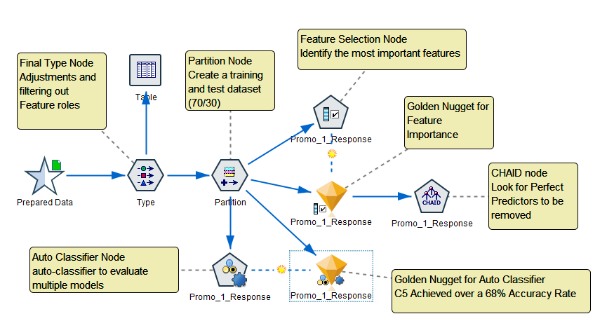
CRISP-DM Framework: Modeling
Example Stream – Do Not Simply Submit as Your Work
Data Preparation Supernode
Type node to filter down fields we want to model
Partition node to split training and testing datasets
Feature selection node to help identify the top features
Auto classifier node to build multiple models
CHAID node (manual) to explore

Slide 21
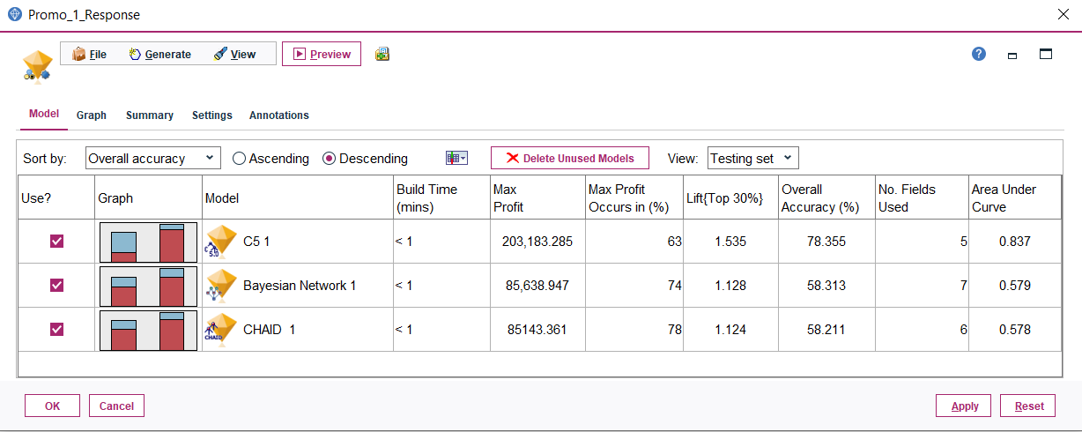
CRISP-DM Framework: Modeling – Auto Classifier Node
Example Stream – Do Not Simply Submit as Your Work
What is this telling us?
The C5 model appears to have the best and the CHAID has the worst
Overall accuracy and lift numbers are not ideal. Additional tuning is needed
Consider an ensemble model

Slide 22
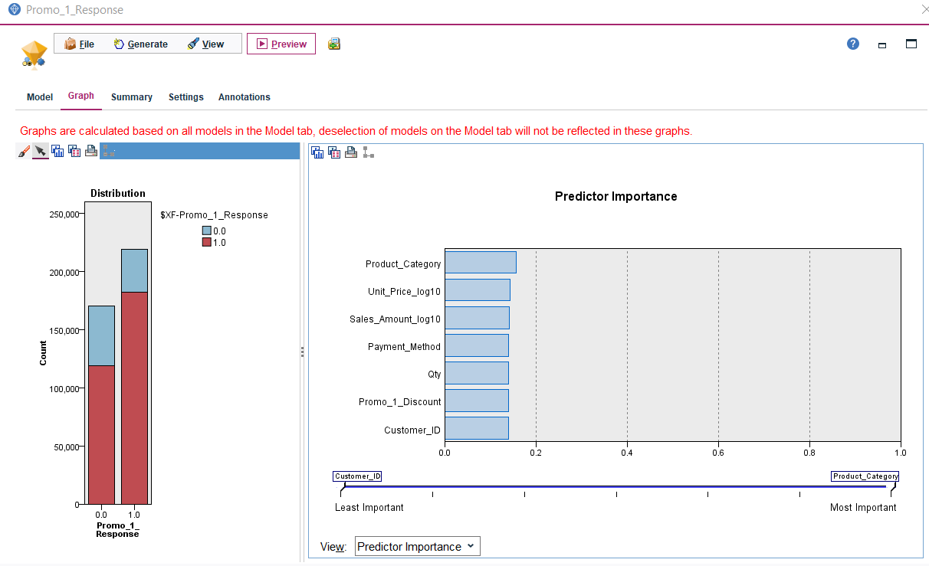
CRISP-DM Framework: Modeling – Predictor Importance
Example Stream – Do Not Simply Submit as Your Work
What is this telling us?
The data has lower predictive value using this current model
Customer ID is still being used in the model. This is an issue because it is only a record identifier

Slide 23
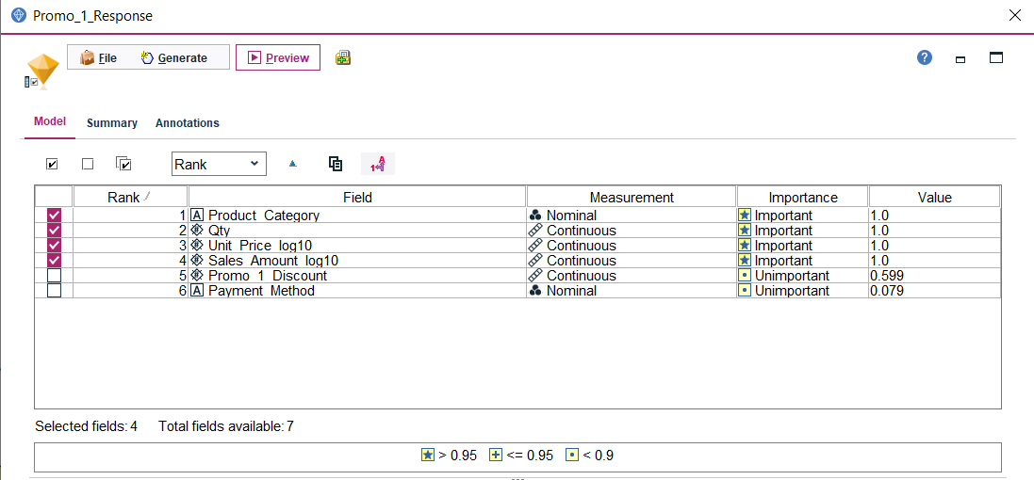
CRISP-DM Framework: Modeling – Feature Selection Node
Example Stream – Do Not Simply Submit as Your Work
What is this telling us?
Four features are important (Category, Quantity, Unit Price and Sales Amount) in predicting Promo Response 1
This is almost a “too perfect” situation. When you see this, you should dive deeper into your model

Slide 24
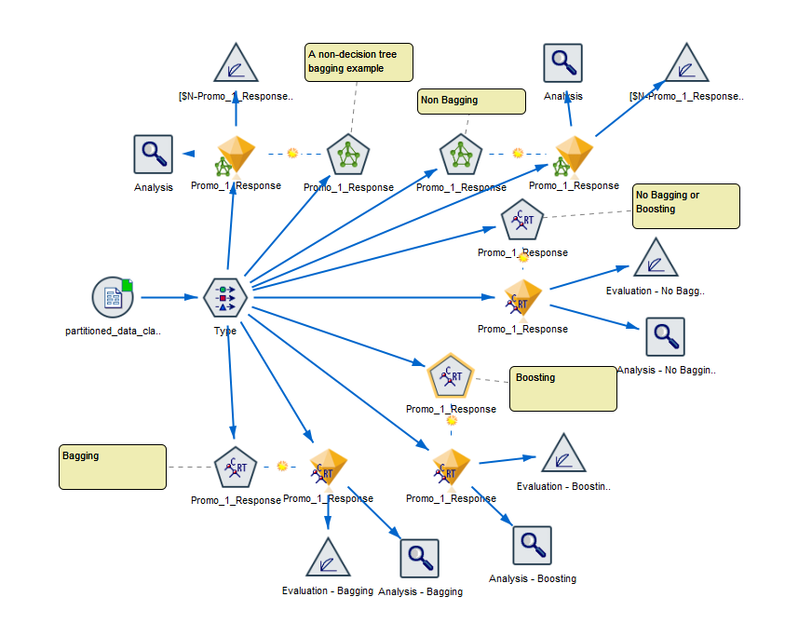
CRISP-DM Framework: Modeling – Ensembles, Bagging, and Boosting
Ensemble Modeling
Ensemble modeling – weak learners are combined to create a strong learner with better performance.
Multiple models using multi-classifiers
Bagging and boosting create random sampling replacements in the training stage
Goal – Higher model stability
Bagging
Every element has the same probability to show up in the final sample
Simple average weighted in parallel
Best option to address high variance (over-fitting)
Boosting
Elements are weighted, resulting in some showing up more often
Weighted average sequentially
Best option to reduce bias (under-fitting)
https://quantdare.com/what-is-the-difference-between-bagging-and-boosting/
https://towardsdatascience.com/ensemble-methods-bagging-boosting-and-stacking-c9214a10a205

Slide 25
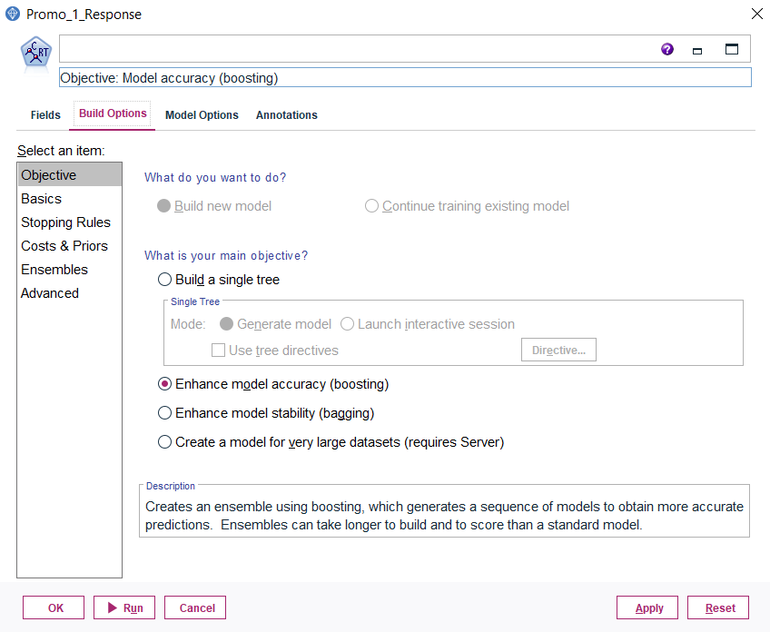
CRISP-DM Framework: Modeling – Bagging and Boosting
How to setup Bagging and Boosting
Under build options, there are options for these techniques.
Not all models are applicable
Doing this will create an ensemble model which combines a sequence of models to get a better prediction.
It will increase the time to build for the better accuracy.

Slide 26
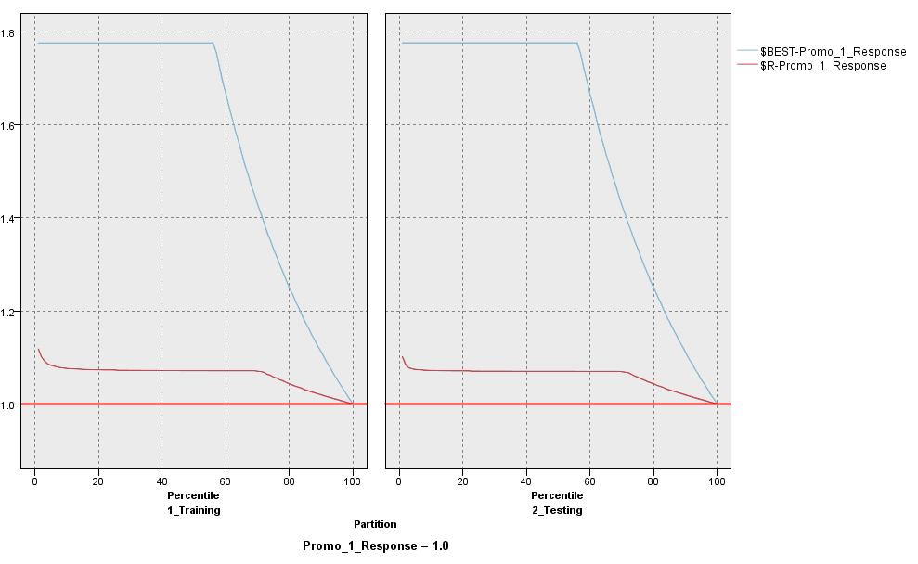
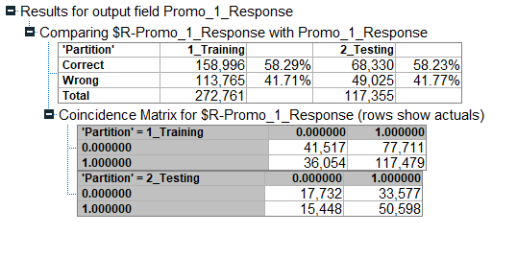
CRISP-DM Framework: Modeling – Bagging
What is this telling us?
The confusion matrix demonstrates that this model has very low ability to predict the outcome correctly.

Slide 27
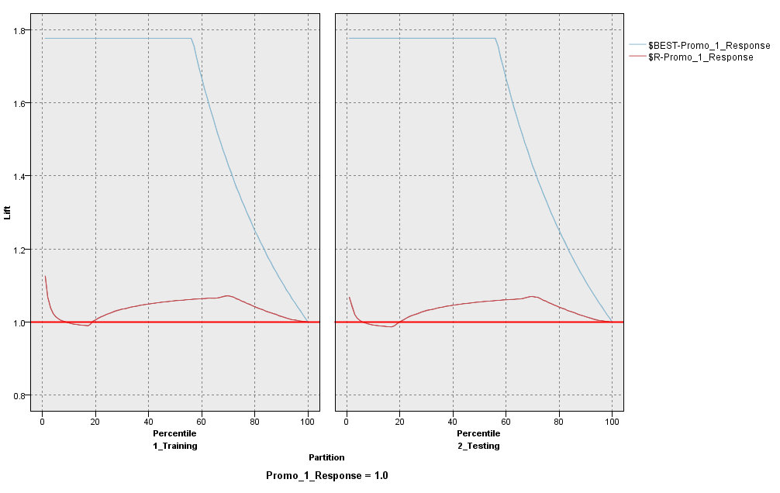
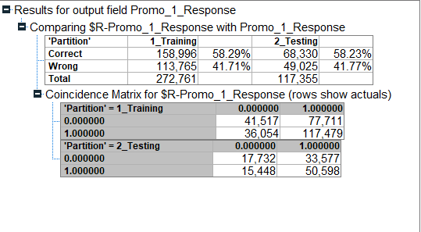
CRISP-DM Framework: Modeling – Boosting
What is this telling us?
The confusion matrix demonstrates that this model has essentially the same problems as bagging

Slide 28
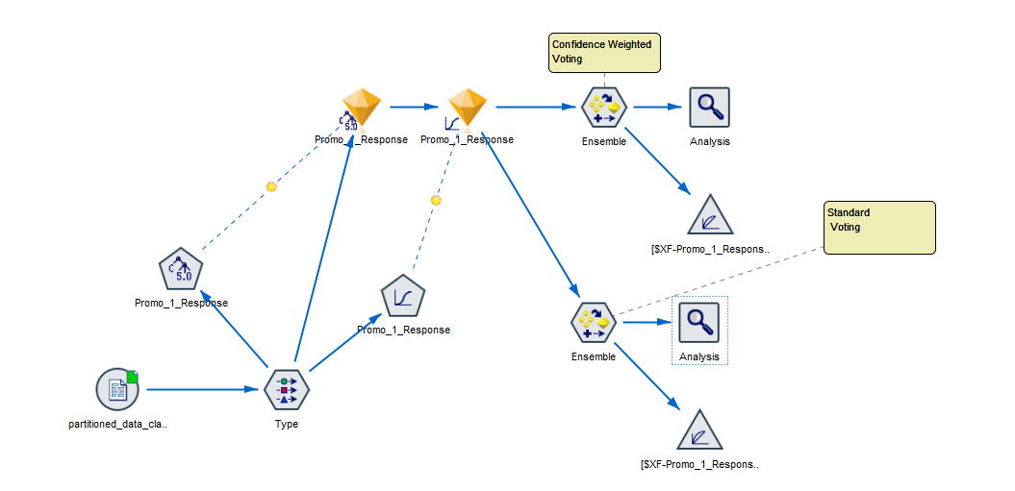
CRISP-DM Framework: Modeling – Ensemble Model

Slide 29
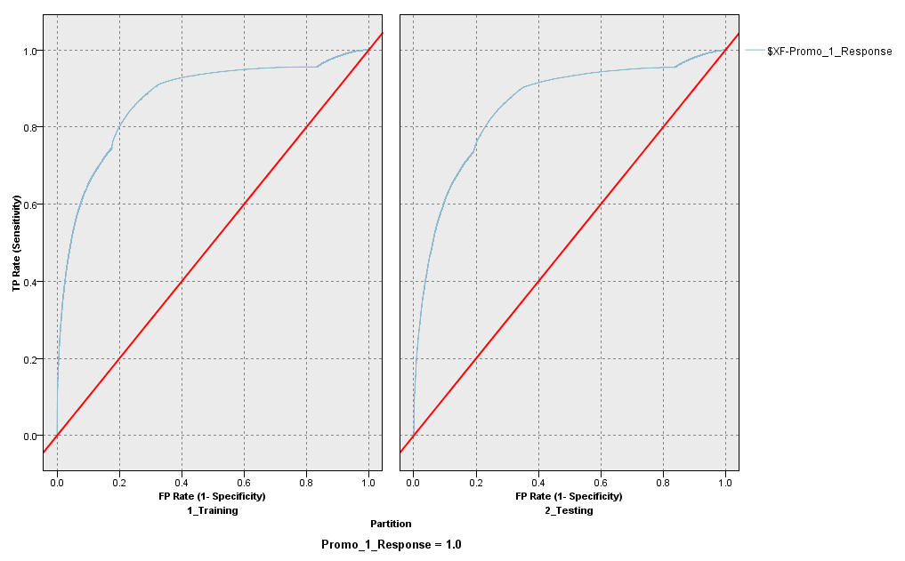
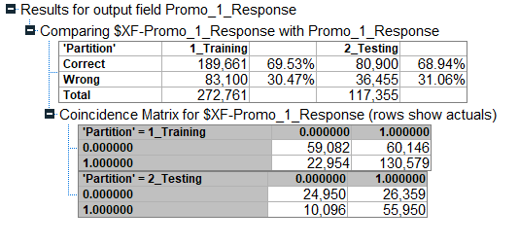
CRISP-DM Framework: Modeling – Ensemble Model
What is this telling us?
The model improves with an ensemble approach.
It still has areas that can be tuned further

Slide 30
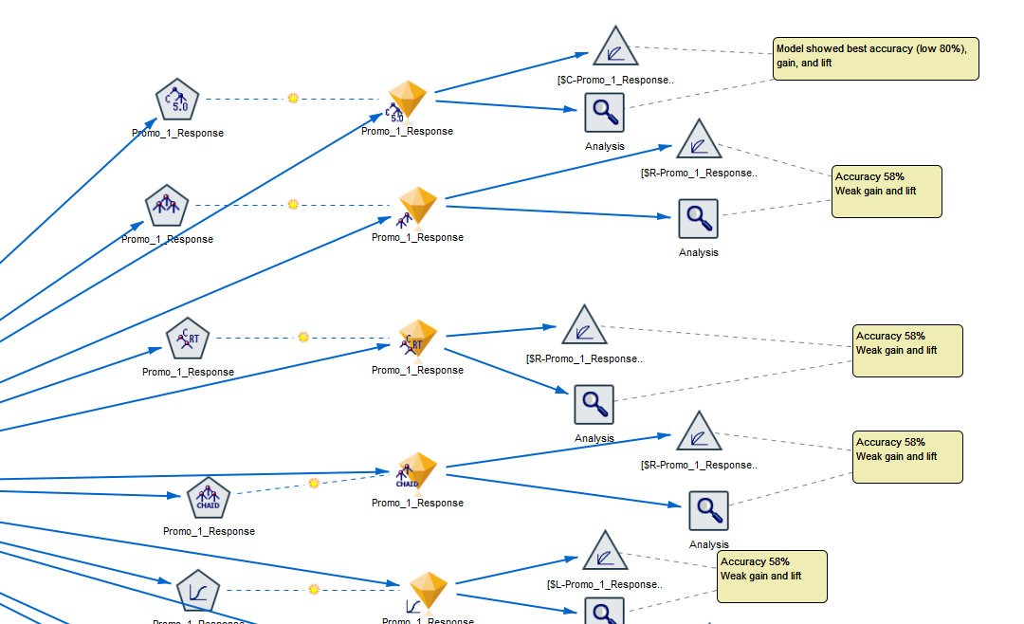
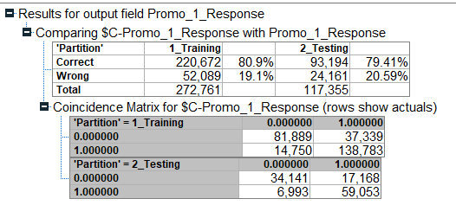
CRISP-DM Framework: Modeling – Side-by-Side Comparison

Slide 31
Weekly Objectives – Week Four
Cross-Industry Process for Data Mining (CRISP-DM)
Two elements for the submission:
Complete any additional evaluation / tuning required on your final model
Prepare a new stream showing the final deployment package
What you will turn in:
Analysis document updated to include the learning from these steps. You may want to have that as a separate document or (preferred) submit as additional information on your current classification analysis document.
Any SPSS streams that you build or revise
Any data beyond the files provided as part of the assignment
CRISP-DM Steps
Modeling
Evaluation
Iteration
Deployment

Slide 32

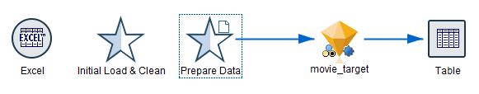
CRISP-DM Framework: Deployment
SPSS Deployment Stream
Analysis Document
Source Data
ETL / Data Prep
Model
Output
Only include the golden nugget model for your final version
The SPSS stream should be able to stand on its own. Make sure you execute it before submitting
Output can either be to a table or a file
This part of the exercise simulates the production of a final model.
It should not have the partition node in the data preparation, because at this stage you would want to see all data including new data beyond your training and test sets.
Any final deployment instructions that would be specific to your model
Results of your analysis (what did you learn?)
This part of the exercise simulates the interpretation of the results from your model.

